Slide 1
Faculty Senate Meeting
January 28, 2021

Slide 2
Meeting procedure
The same rules apply over virtual meetings as over in-person meetings
Only Senators may debate motions
Only Senators can vote
If you are not a Senator, or a proxy, you cannot vote or debate
Do not speak over someone, or out of order
Raise your hand within the Zoom app
The President will call on you and then you will have the floor
Unless you have been recognized (been told you have the floor), you may not speak

Slide 3
Agenda
Call to Order and Roll Call
K.C. Dolan, Secretary

Slide 4
Agenda
Approval of Minutes
November 19, 2020

Slide 5
Agenda
III. Campus Reports
A. Staff Council
A. Kossuth

Slide 6
Agenda
III. Campus Reports
B. Student Council
L. Hierlmeier

Slide 7
Agenda
IV. Guest Speaker
A. UM System Vice President for Information Technology
B. Chancellor

Slide 8
Email Security Policy and IT Update for S&T
January 28, 2021
Beth Chancellor, VP for IT

Slide 9
Need for Change
Several successful email breaches via phishing with significant financial and reputational costs to the University
Data privacy regulations and legal responsibilities
Legal and security involvement in legal cases that have nothing to do with the University (personal use of UM email)
Mitigate risk and reduce cost
Employee education alone is not working
Need to take a more corporate view of email and other IT resources

Slide 10
Proposed email policy elements
Eliminate storing of certain types of data in email accounts (SSNs, credit card numbers, patient information, etc.)
Prohibition of the transmission of certain types of data except through encrypted means
Sweeping of inboxes and sent items (proposed at 4-5 years)
Subfolders are not under consideration for sweeping at this time
Strict adherence to quotas
Supervisors must assist with transfer of files/records before employees leave
Employees must use UM email to conduct their University-related work and conversely, must minimize personal use of UM email (i.e., employees need to have a personal email account)
Notes:
2018 GDPR – the reason we have to sign off on "cookies" every time we go to anyone's website
2020 - We are not subject to CCPA, but this type of legislation has been introduced multiple times in Missouri. New privacy regs (think Covid results, etc.) are being implemented often and it needs to be on our minds.
Marriott fined 123 million for 2018 Megabreach as a GDPR violation
British Airways faces 230 million fine for passenger data breach

Slide 11
Proposed email policy elements
Former students, alumni and retirees must have a purpose/need to keep UM email going forward
For Retirees - if/when the UM email account is needed to support their ongoing academic/research endeavors, to facilitate University business continuity or for volunteer activities in support of their department, school/college, campus or the University in general
Current retiree accounts are to be grandfathered
Student accounts – deactivated 12 months from the end of the last term enrolled
Students can request an extension for a number of reasons
All abandoned accounts will be deactivated (not logged into in 6 months)
Notes:
2018 GDPR – the reason we have to sign off on "cookies" every time we go to anyone's website
2020 - We are not subject to CCPA, but this type of legislation has been introduced multiple times in Missouri. New privacy regs (think Covid results, etc.) are being implemented often and it needs to be on our minds.
Marriott fined 123 million for 2018 Megabreach as a GDPR violation
British Airways faces 230 million fine for passenger data breach

Slide 12
Next Steps
Policy proposal to General Officers and Senior Leaders as soon as is reasonably possible
Technical and policy enforcement will take several months
Email for life is not a policy, it’s a practice
The draft policy and associated procedures codifies retiree email eligibility with limits
We will continue to work with retiree associations, campus leaders and student government to define post-graduate and post-employment processes

Slide 13
Questions????

Slide 15
Agenda
V. President’s Report
S. Raper

Slide 16
General Items
Revised By-Laws Open Forum scheduled for February 16, 3:00 - 5:00 p.m.
Revisions will be sent to Faculty Senators and all faculty for review prior to the forum
New Degree Proposal – BS in Environmental Science (CASB, Bio Sci) – requires FS and CCC approval
No issues with curriculum
Proposal with Proforma indicates strong positive margin
Current Faculty Senators and other attendees that are the proposal authors may offer comment
Can and will distribute to Faculty Senators if necessary
Chancellor Dehghani and Interim Provost Roberts have been asked to comment on several issues of interest to faculty in their reports

Slide 17
IFC – 12/11/2020 and 01/22/2021
Continuing work on various CRR’s – IFC members serve as faculty input
Budget Discussions
Enrollment at all campuses
BOC meeting: February 4, 2021
General discussion with President Choi, some issues of interest include “consolidations”, enrollments, budget, Council of Chancellors
eLearning and “certification”

Slide 18
Agenda
VI. Administrative Reports
A. Chancellor’s Report M. Dehghani

Slide 19
Chancellor’s Report

Slide 20
Agenda
VI. Administrative Reports
B. Interim Provost’s Report S. Roberts

Slide 21
Student Recruiting and Retention
2019 2020 2021
Freshman Applications (ytd) 4445 4902 4777
Freshman Admits (ytd) 3455 3808 3930
Freshman Deposits (ytd) 694 593 885
M.S. Applications (ytd) 323 336 663
M.S. Admits (ytd) 97 34 250
Ph.D. Applications (ytd) 204 181 341
Ph.D. Admits (ytd) 47 9 60
Freshman Fall-to-Spring Retention 91.5% 93.2% 94.7%
Thank you!

Slide 22
Submission of Faculty Annual Performance Evaluations
Department chairs will be submitting faculty annual performance evaluations through MyVita.
At the beginning of the annual performance evaluation process, faculty can submit their annual report of teaching, research, and service as an attached pdf file in MyVita.
Using department-level standards for teaching, research and service – and the faculty member’s workload distribution – the chair will rate the faculty member as satisfactory or unsatisfactory in teaching, research, and service, and an overall evaluation of satisfactory or unsatisfactory will be provided (CRR 310.015.B.1.b).
The chair may note significant concerns about performance in a category, yet can assign a satisfactory rating in that category if the faculty member has met the department’s standards in that category, and create an improvement plan to address the concern (CRR 310.015.B.1.c).
For the annual performance evaluation, one unsatisfactory evaluation in either teaching or research (or any major area of assignment) will result in an overall unsatisfactory evaluation (CRR 310.015.B.1.c).
The chair submits the ratings and narrative in MyVita in the electronic form or attached pdf.

Slide 23
Why this change and why now?
This reporting stream will bring S&T to consistency with other UM System universities and most other public universities.
The Board of Curators is expecting greater transparency of annual performance evaluation results (chairs-deans-provost-chancellor) to help universities reward and promote effectiveness.
For the annual performance reviews for CY2019 (conducted in Spring 2020), there was significant variation and inconsistency across and within departments in terms of conducting and reporting annual faculty performance reviews.

Slide 24
What was the nature of the variation and inconsistency in how departments conducted and reported faculty annual performance reviews for CY2019?
Some departments reported faculty performance ratings through MyVita, but not narrative statements (these were held at the department and included the ratings in teaching, research, and service).
Some departments reported faculty performance ratings through MyVita, but not narrative statements (these were held at the department and did not include the ratings in teaching, research, and service).
Some departments reported faculty performance ratings as well as narrative statements through MyVita.
Some departments reported nothing through MyVita.
Some departments reported different ratings for the same individual faculty member depending on if the report was submitted through MyVita or submitted to the dean on a college form. It is unknown if the faculty involved were, or are, aware of this.
Some departments used a different rating scale than is required by the CRR 310.015.
Some departments used the rating scale required by the CRR 310.015, but assigned both a satisfactory rating and an unsatisfactory rating in a single performance category.
Some departments did not follow CRR 310.015 because they rated overall performance as satisfactory even though either research or teaching performance was rated as unsatisfactory.
Some departments followed CRR 310.015 by rating overall performance as unsatisfactory if either research or teaching performance was rated as unsatisfactory.
Within some departments, some faculty were rated satisfactory overall if research or teaching performance was rated as unsatisfactory, while other faculty were rated as unsatisfactory overall if research or teaching performance was rated as unsatisfactory.
Our faculty colleagues deserve a far more transparent, fair, and
consistent practice of faculty performance evaluations.

Slide 25
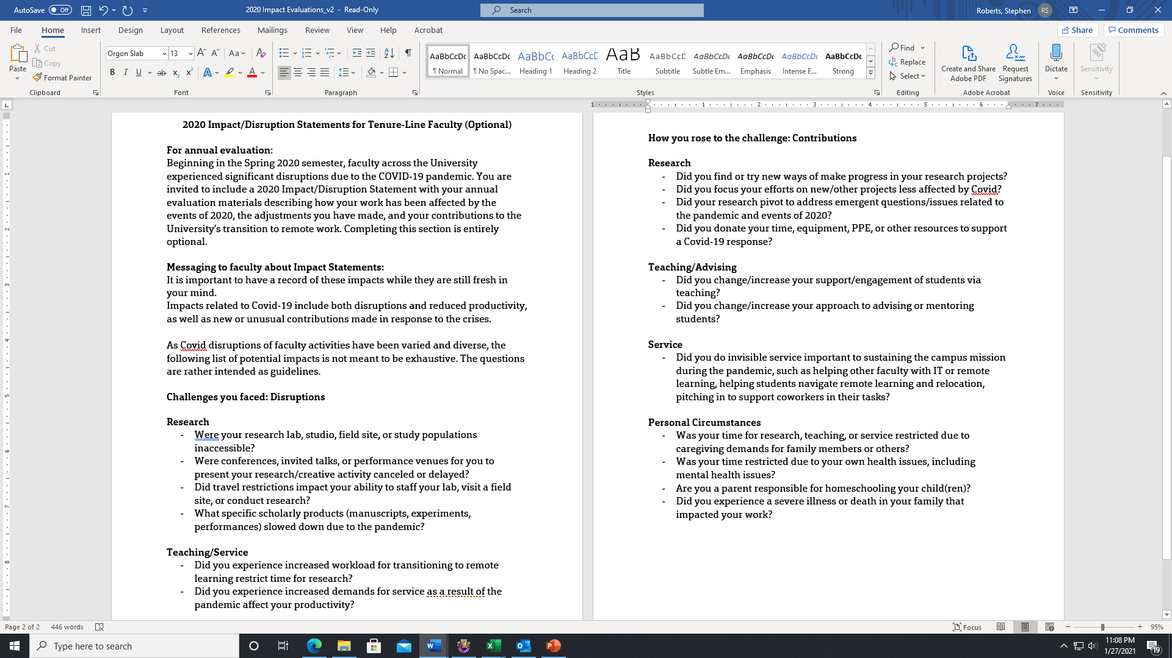
COVID19 Impact/Disruption Statement

Slide 26
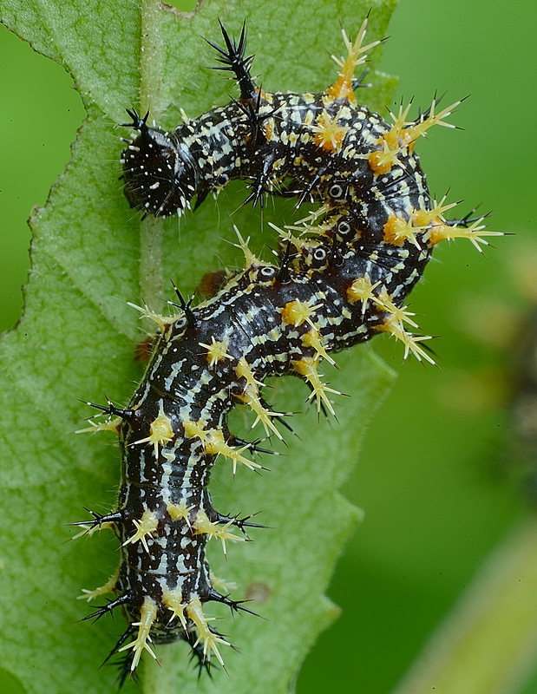
Questions?
B. Cammarata

Slide 27
Agenda
VII. Reports of Standing Committees
A. Curricula S. Raper

Slide 28
28 January 2021
CCC Meetings
16 December
10 February (upcoming)
Total Committee Activity
45 Course Change requests (CC forms)
24 Program Change Form (PC forms)
6 Experimental Course requests (EC forms)

Slide 29
28 January 2021
Course Changes (CC) Requested Pg 1
File: 53.2 BIO SCI 1219 : General Biology Lab
File: 1778.4 BUS 5111 : Business Negotiations
File: 2317.10 BUS 5150 : Customer Focus and Satisfaction
File: 4350.10 BUS 5910 : Privacy and Information Security
File: 668.1 BUS 6121 : Leadership
File: 4069.5 COMP SCI 3601 : Digital Forensics
File: 4748 EDUC 1055 : Introduction to Early Childhood Education
File: 4745 EDUC 1820 : Early Childhood Program Management
File: 1174.3 EDUC 2310 : Education Of The Exceptional Child
File: 4746 EDUC 2401 : School, Family, and Community Partnerships
File: 4747 EDUC 2440 : Observation and Assessment of Young Children
File: 2494.12 EDUC 3203 : Introduction to STEM Education
File: 941.3 EDUC 3211 : Child Development

Slide 30
28 January 2021
Course Changes (CC) Requested Pg 2
File: 1771.6 EDUC 3215 : Teaching Reading in Elementary and Early Childhood Settings
File: 1758.10 EDUC 3216 : Instructional Literacy in the Content Area
File: 1869.9 EDUC 3217 : Analysis and Correction of Reading Difficulties
File: 1870.7 EDUC 3218 : Language Arts for Elementary and Early Childhood Teachers
File: 4517.10 EDUC 3220 : Teaching Science in the Elementary and Early Childhood Classroom
File: 2541.12 EDUC 3221 : Methods of Teaching Math
File: 176.8 EDUC 3280 : Instructional Strategies in the Content Area
File: 4519.8 EDUC 3430 : Diverse Literature for Children
File: 4518.7 EDUC 3530 : Teaching Integrated Social Studies and Humanities
File: 1189.7 EDUC 4299 : Student Teaching
File: 4754 ELEC ENG 5355 : Process Control System Safety, Security and Alarms
File: 842.1 ELEC ENG 5500 : Electric Drive Systems
File: 306.1 ELEC ENG 5570 : Extra High Voltage Engineering
File: 2211.1 ELEC ENG 6500 : AC Drives: Dynamic and Control
File: 4308.9 FRENCH 4330 : Professional Business French

Slide 31
28 January 2021
Course Changes (CC) Requested Pg 3
File: 2491.4 HISTORY 4097 : Senior Project
File: 925.11 IS&T 4641 : Digital Commerce and IoT Analytics
File: 2412.1 IS&T 5251 : Management and Leadership of Technological Innovation
File: 4764 IS&T 6251 : Technological Innovation, Entrepreneurship, and Economic Development
File: 4760 MATH 1210 : Calculus I-A
File: 4761 MATH 1211 : Calculus I-B
File: 2178.3 MATH 1212 : Survey of Calculus
File: 116.5 MATH 1214 : Calculus I
File: 1695.5 MATH 1215 : Calculus II
File: 340.4 MATH 2222 : Calculus III

Slide 32
28 January 2021
Course Changes (CC) Requested Pg 4
File: 4757 MATH 5601 : Introduction to Numerical Analysis
File: 4061.3 MATH 5602 : Mathematical Foundation of Finite Element Methods
File: 1903.10 MET ENG 3220 : Introduction To Extractive Metallurgy
File: 2639.1 NUC ENG 3221 : Reactor Fluid Mechanics
File: 1981.1 NUC ENG 4312 : Nuclear Radiation Measurements and Spectroscopy
File: 2371.4 NUC ENG 4496 : Nuclear System Design I
File: 4750 POL SCI 4320 : Policy for Science, Technology, and Innovation

Slide 33
28 January 2021
11 Nov 2020
Program Changes (PC) Requested Pg 1
File: 239.16 ANA&DTA-MI : Business Analytics and Data Science Minor
File: 253.9 AI-MI : Minor in Artificial Intelligence and Machine Learning in Business
File: 142.47 AP MATH-BS : Applied Mathematics BS
File: 230.18 AUTOENG-MI : Minor in Automation Engineering
File: 146.26 BIO SC-BA : Biological Sciences BA
File: 147.18 BIO SC-BS : Biological Sciences BS
File: 247.12 CYBERMG-MI : Cybersecurity Management and Information Assurance Minor
File: 37.3 E/T ECN-MI : E/T Economics Minor
File: 76.3 IN ECN-MI : International Economics Minor
File: 73.9 IS&T-MS : Info Science & Tech MS
File: 123.8 PRE-MED-MI : Pre-Medicine Minor
File: 136.1 THEATRE-MI : Theatre Minor

Slide 34
28 January 2021
11 Nov 2020
Program Changes (PC) Requested Pg 2
File: 292.6 AI-CT : AI, Mach Lrn & Auto for Bus CT
File: 254.10 AUTOEN-CTU : Undergraduate Certificate in Automation Engineering
File: 281.2 AUTOENG-CT : Automation Eng & PLC CT
File: 294.2 DATA WR-CT : Business Intelligence CT
File: 297.2 DSCMGMT-CT : Digital Supply Chain Mgmt CT
File: 298.2 E&S COM-CT : Elec & Social Commerce CT
File: 288.2 ENT&TEC-CT : Entrepreneur & Tech Innovat CT
File: 369 PROPOSED : Advanced Materials for Sustainable Infrastructure CT
File: 370 PROPOSED : Building Systems Engineering CT
File: 372 PROPOSED : Chemical Process Engineering CT
File: 371 PROPOSED : Surface Water Resources CT
File: 368 PROPOSED : UCT - Technology, Philosophy, and Ethical Futures

Slide 35
28 January 2021
For Informational Purposes; No Senate Approval Required
Experimental Courses (EC) Requested
File: 4749 BIO SCI 5001.007 : Forest Insect Diversity & Ecology
File: 4762 COMP ENG 5001.003 : Introduction to Convex Optimization
File: 4755 COMP SCI 5001.012 : Fundamentals of Cyber-Physical Systems
File: 4756 COMP SCI 6001.007 : Advances in Cyber-Physical Systems
File: 4758 MATH 6001.008 : Finite Difference Methods for Partial Differential Equations
File: 4759 PET ENG 6001.012 : Advanced Well and Drilling Technology

Slide 36
28 January 2021
Curriculum committee moves for FS to approve the 24 PC and 45 CC form actions
Discussion: Questions or comments?

Slide 37
Agenda
VII. Reports of Standing Committees
B. Public Occasions S. Sedigh Sarvestani

Slide 38
Public Occasions Committee Report
Dr. Sahra Sedigh Sarvestani, Chair
Motion
The Public Occasions Committee moves that Saturday, October 9 be adopted as the date of Homecoming 2021.

Slide 39
Agenda
VII. Reports of Standing Committees
C. Administrative Review W. Huebner

Slide 40
Administrative Review Committee
2020-2021 Members
Diana Ahmad
Wayne Huebner, Chair
Bih-Ru Lea
Kelly Liu

Slide 42
Administrative Review Committee
Positions suggested for review
Chancellor (Dehghani)
Vice Chancellor Finance & Operations (Plain )
Chief Diversity Officer (Outar)
Deputy Provost for Academic Excellence (Brow)
Vice Provost and Dean Enrollment Management (Sivadasan)
Vice Provost Global Learning (Moore)

Slide 43
Administrative Review Committee
Proposed timeline and process
Action | Time
Review list to faculty senate for approval | January 28th
Job descriptions | February 12th
Development of questionnaires | February
Questionnaires to FS for review/approval | February 25th
Statement of accomplishments due | February 26th
Review of administrations | March 15th – April 2nd
Results to FS officers | April 16th
Final report to FS | May 14th

Slide 44
Administrative Review Committee
Review Participants
All ranked tenure/tenure-track (TT) and ranked non-tenure-track (NTT) faculty, including those holding administration positions, are eligible to participate in the surveys.

Slide 45
Agenda
VII. Reports of Standing Committees
D. Academic Freedom and Standards
K. Kosbar

Slide 46
Academic Freedom & Standards Committee
Instructional Modes
K. Kosbar
Chair AF&S Committee
1/28/21

Slide 47
Instructional Modes
Instructors and students have been sending questions to the S&T Academic Freedom and Standards (AF&S) committee, regarding the implementation of various instructional modes.
Some assumed the committee, or the Faculty Senate, had a voice in the creation of these instructional modes – perhaps because of recent activity to modify S&T Student Academic Regulations, with respect to the time commitment per credit hour.
The committee has begun a discussion of the topic, but has no recommended actions at this time.
This presentation summarizes some of the instructional mode specifications, and a sample of questions directed toward the AF&S committee.
Additional comments for the AF&S committee from the campus community are welcome.

Slide 48
S&T Academic Regulations
S&T Student Academic Regulations specify the amount of instructional time, preparation time, and total time students should expect to spend in a class.
A credit hour is the credit obtained from passing a course requiring approximately 800 minutes of instructional time during a session. Students may need to spend an additional 1,600 minutes preparing and studying, for a total time commitment during the session of 2,400 minutes … Laboratory and experiential learning courses may choose a different balance between instructional and preparation/study time…
The regulations also specify who determines if absences are allowed, and what consequences they may have
The individual instructor determines the number and nature of absences allowable in each course … Sanctions may be imposed for excessive absences up to and including dismissal from the course. If the instructor intends to attach a formal sanction (grade reduction or dismissal from the course) to inadequate attendance, they must include in the course syllabus the specific expectations and steps to be taken in such cases.
S&T Student Academic Regulations do not define, recognize, or reference modes of instruction.
https://registrar.mst.edu/academicregs/

Slide 49
Interactions / Modes / Formats
S&T Registrar’s web pages recognizes:
Two types of interaction
face-to-face
online
Six modes of instruction for a class
Classroom Based
Blended Course
Primarily Online Synchronous
Primarily Online Asynchronous
Wholly Online Synchronous (starting FS21)
Wholly Online Asynchronous (starting FS21)
Three class formats
Recitation / Seminar / Discussion
Laboratory
Independent Study
There are specifications as to how much of each type of interaction is allowed for each mode of instruction.
https://registrar.mst.edu/classofferings/courseinstructionmodes/

Slide 50
Instructional Mode Comparison - Mizzou
Traditional
0% online
Video recordings of live presentations allowed to be posted for viewing after the conclusion of the presentation
Web Facilitated
1% to 29% online
Blended
30% to 70% online
Students may be rotated between in-person and online
100% of lectures may be pre-recorded, with small in-person meetings
Online (Sync & Async)
80% to 100% online
E-Learning
100% online

Slide 51
Instructional Mode Comparison - UMKC
In Person
Widely used, but details not specified by UMKC registrar’s office
Blended
5 or more meetings on-campus (approx. 0% to 90% online)
Online Campus
1 to 4 meetings on-campus (approx. 90% to 98% online)
Online (Sync & Async)
No meetings on-campus (100% online)

Slide 52
Instructional Mode Comparison - UMSL
In Person
0% to 29% online
Blended
30% to 74% online
Partially Online
75% to 99% online
Online
100% online

Slide 53
Instructional Modes – S&T
Classroom Based
0% to 29% online
Forced to online during campus weather/other emergency
Blended
30% to 74% online
Primarily Online
75% to 99% online
Wholly Online
100% online
Starting fall semester 2021

Slide 54
Questions
S&T Student Academic Regulations state “The individual instructor determines the number and nature of absences allowable in each course.” Do the instructional mode requirements alter this?
If a student physically attends less than 71/30/1 percent of a classroom/blended/partially-online class, is the instructor obligated to drop them, or give them a failing grade?
If a student physically attends more than 0/75/30 percent of a wholly-online/primarily-online/blended course, is the instructor obligated to drop them, or give them a failing grade?
Is an instructor allowed to present more than 29/74/99 percent of classroom-based/blended/primarily-online courses online, provided they make available at least 71/30/1 percent of the same course material face-to-face? Example – a classroom instructor allows students to attend every lecture live, but also presents it live as a zoom session.

Slide 55
Questions
If the instructor presents some of the course material online, are they obligated to monitor student use of the online resources, to verify students has devoted sufficient time to qualify as “attending” the online portion of the course?
If an instructor offers to attend a classroom in-person to present a lecture, but knows in advance that all students would prefer to participate remotely, is the instructor allowed to give the lecture only as a zoom session, and count it as an face-to-face meeting? If so, can the instructor give the zoom meeting from any location, or must they be in the assigned (now empty) classroom during the zoom session?
Will blended and partially online courses be assigned sufficient classroom space, to allow the instructor to meet with the entire section at once, for the maximum amount of time an instructor is allowed to do so? If not, where is the required face-to-face interaction expected to occur? How small must the student groups be, and how much time is the instructor expected to invest in these face-to-face meetings?

Slide 56
Questions
Is an instructor required to be in a classroom during a face-to-face meeting? (In at least one classroom-based section this semester, the instructor requires students to be in the classroom at class time, while he presents the material over a zoom session, from a distant location.)
Will the declaration of weather/pandemic/other emergencies, which force movement of face-to-face meetings to online, change the percentage of course content which must be held face-to-face? If so, will this change be automatic, or at the discretion of some person or group? How will it be communicated to instructors and students?
Are instructors obligated to put the minimum and maximum attendance guidance/rules for their assigned instructional mode in their syllabi - especially if it can result in a student being dropped from, or failing, a course?

Slide 57
Questions
What, if any, meeting space will the university provide to instructors who are required to conduct 1% or more of their classes face-to-face?
Will the registrar reserve a room large enough to accommodate 100% of the enrolled students for the amount of time the class will be taught face-to-face, for exams or other purposes? If not, will any meeting space other than the instructor’s office be made available?
If a classroom/lab is available only for a portion of the class meeting time, or only for a portion of the students enrolled in the class, who will decide on the appropriate size of the space and times it is available to the class?

Slide 58
Agenda
VII. Reports of Standing Committees
E. Committee on Excellence in Teaching
D. Oerther

Slide 59
From CET 1.0 to SET 2.0
Daniel B. Oerther
Chair, Committee for Effective Teaching 2020-2021

Slide 60
Original Charge
In September 2019, the Curators asked the Provost to:
Identify and report baseline teaching effectiveness;
Develop and implement a plan to improve teaching effectiveness; and
Assess improvement.

Slide 61
Process Diagram (from CET 1.0 to SET 2.0)
Missouri S&T defines effective teaching as locally optimized instruction - sensitive to students, leveraging faculty expertise, and supported by institutional resources - which achieves measured improvements in the knowledge, skills, and attitudes of students.
The four attributes of effective teaching we intend to assess are:
up-to-date content;
an intentional approach to pedagogy;
clarity of assignments, schedule, due dates, and grading criteria; and
outcomes-based instruction
General Questions
Content Questions
Pedagogy Questions
Communication Questions
Instruction Questions

Slide 62
Process Diagram (State Mandated to SET 2.0)
1) I would tell other students that the instructor was effective in communicating the content of the course.
General Questions
2) I would tell other students that the instructor described and consistently followed course and grading policies.
Content Questions
3) I would tell other students that the instructor was prepared for class.
Pedagogy Questions
4) I would recommend this instructor to other students.
Communication Questions
Instruction Questions

Slide 63
Process Diagram (Campus Questions to SET 2.0)
1) Evaluate this course, independent of the instructor’s effectiveness, in terms of its educational value to you.
General Questions
2) Rate the instructors use of assignments and tests for facilitating your learning of the subject matter.
Content Questions
3) Rate the instructor’s concern for your understanding of the materials.
4) Rate the instructor's preparation for class.
Pedagogy Questions
5) Rate the instructor's ability to communicate.
Communication Questions
6) Rate the instructor's ability to stimulate and motivate you.
Instruction Questions
7) Rate the overall teaching effectiveness of this instructor.

Slide 64
Final Product SET 2.0
1) I would tell other students that the instructor was effective in communicating the content of the course.
General Questions
2) I would tell other students that the instructor described and consistently followed course and grading policies.
3) I would tell other students that the instructor was prepared for class.
Content Questions
4) I would recommend this instructor to other students.
Pedagogy Questions
1) Evaluate this course, independent of the instructor’s effectiveness, in terms of its educational value to you.
2) Rate the instructors use of assignments and tests for facilitating your learning of the subject matter.
Communication Questions
3) Rate the instructor’s concern for your understanding of the materials.
4) Rate the instructor's preparation for class.
Instruction Questions
5) Rate the instructor's ability to communicate.
6) Rate the instructor's ability to stimulate and motivate you.
7) Rate the overall teaching effectiveness of this instructor.

Slide 65
Agenda
VII. Reports of Standing Committees
F. Budgetary Affairs
M. Fitch

Slide 66
Budgetary Affairs Committee
Jan 28, 2021
Referrals
None
Continuing referrals:
Report on the “big picture balance sheet”
Current and next FY budget

Slide 67
How does KI spending work?
Two separate legal entities
Kummer Institute Foundation
S&T
Endowment
Existing investment plan
$ Yield
S&T proposes budget
Board approves budget
Accounts made (normal approval chain)
Spend, weekly approval by executive committee (Kummer, Dehghani, Provost, CFO, aVC Ruth, Dir. Cerney, VCA [Budget keeper], aVC Verkamp, VCR, Deans, aVC Careaga)
Draw approval
Quarterly draw and report
(CFO and Dir. Cerney)

Slide 68
Big Picture Budget
Budget on target so far
Spring enrollment down more than expected, but summer was more than expected
Anticipating more gifts (low estimate in budget), restricted spending = capital projects
Remain hopeful to replace vacated positions (≠ layoffs)
Governor released $4.68 MM of COVID-19 federal pass-through, only for maintenance and repair, tasked to (1) power plant demolition and (2) electrical substation replacement and relocation
Federal COVID relief v2.0 has $8.1 MM for S&T.
$2.6 MM direct to student aid (US UG),
no guidance from DHE yet on $5.5 MM, hoping to use as lost revenue replacement (= GO funds)

Slide 69
Three-year trends in dep’ts
Academic departments
Expenditures of GO and endowment monies
‘Income’ from GO and endowments
Other departments:
Include auxiliary (Havener and Res Halls)
Showing only ‘of interest’; not incl. Sponsored Proj. which took $5 MM GO cut
Excludes ‘other’, about $1.2 MM; 335K GGPE + 835K Global
Excludes grants and contracts (research $)
budget (= this year) assumes very little (CEC = $1.2 MM)
actuals much larger (CEC = $14.5 MM) but mostly ‘pass through’

Slide 70
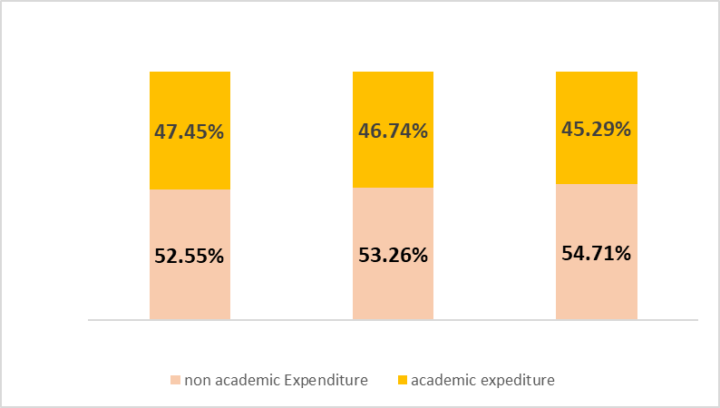
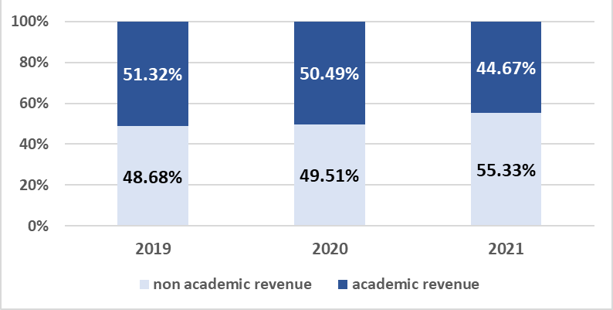
Overall Revenue & Expenditures
In total, decreased in academic units and increased in non-academic units
Academic units as a whole projected to have deficit in 2021
non academic expenditure
academic expenditure

Slide 71
Academic Funding, Colleges
Academic expenditure stays relatively steady.
Academic revenue and transfer decrease in CEC while increase in CASB
 | Total Expenditure (MM) |  |  |  | Total Revenue + Transfers (MM)
 | CASB |  | CEC |  | CASB |  | CEC
2019 | $27.3 | 35% | $50.7 | 65% | $27.8 | 32% | $60.4 | 68%
2020 | 25.9 | 36% | 45.6 | 64% | 25.3 | 35% | 47.7 | 65%
2021 | 24.8 | 35% | 46.8 | 65% | 22.2 | 37% | 38.4 | 63%
Colleges combined 8.2 % expenditure decrease 2019 – 2021, -$6.4 MM

Slide 72
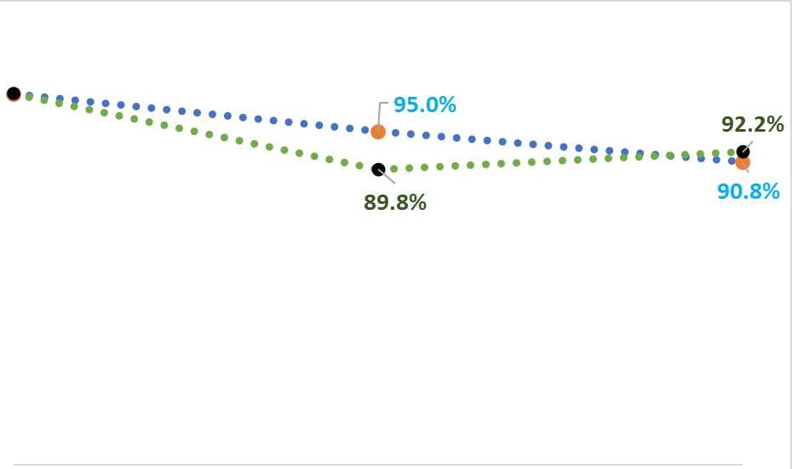
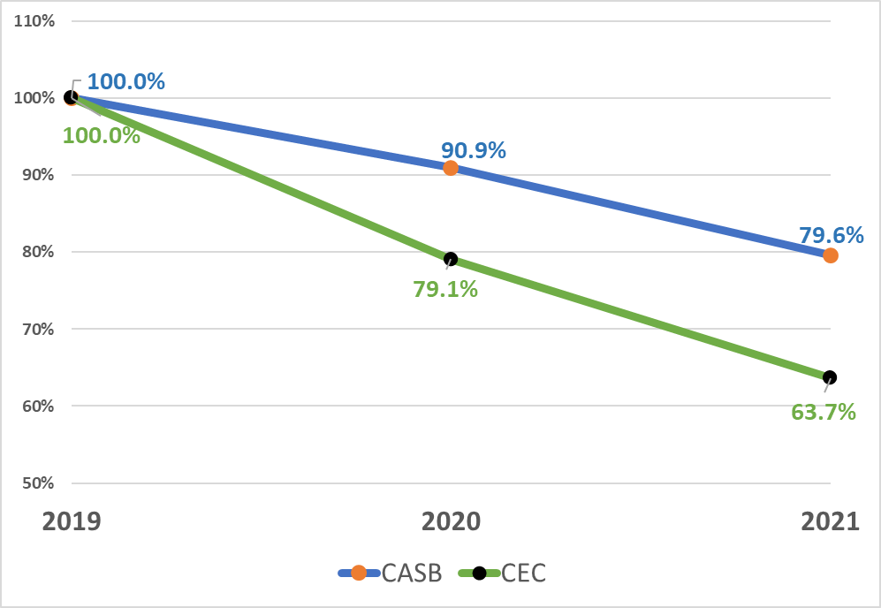
Overall Revenue & Expenditures
Revenue & Transfer decreased more significantly in CEC than in CASB
Expenditure decreased in CASB more steadily than in CEC
CASB $ 2.6 MM deficit
CEC, $8.4 MM
Revenue & Transfer
Expenditures
Note:
Year 2019 is used as the base to compute the percentage for both (1) Revenue & Transfer and (2) Expenditure

Slide 73
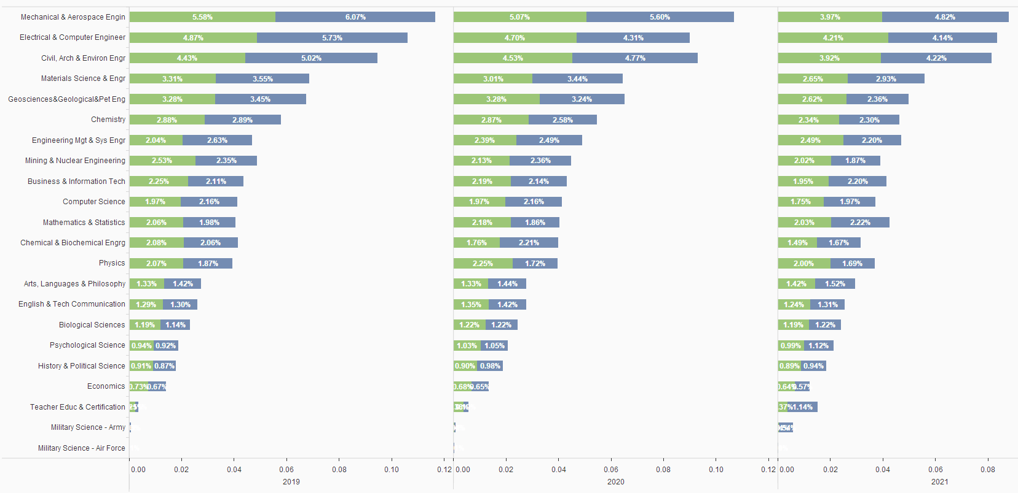
Academic Depts
Most departments’
Revenue & Transfer
Expenditure
compared to S&T total stay similar over years

Slide 74
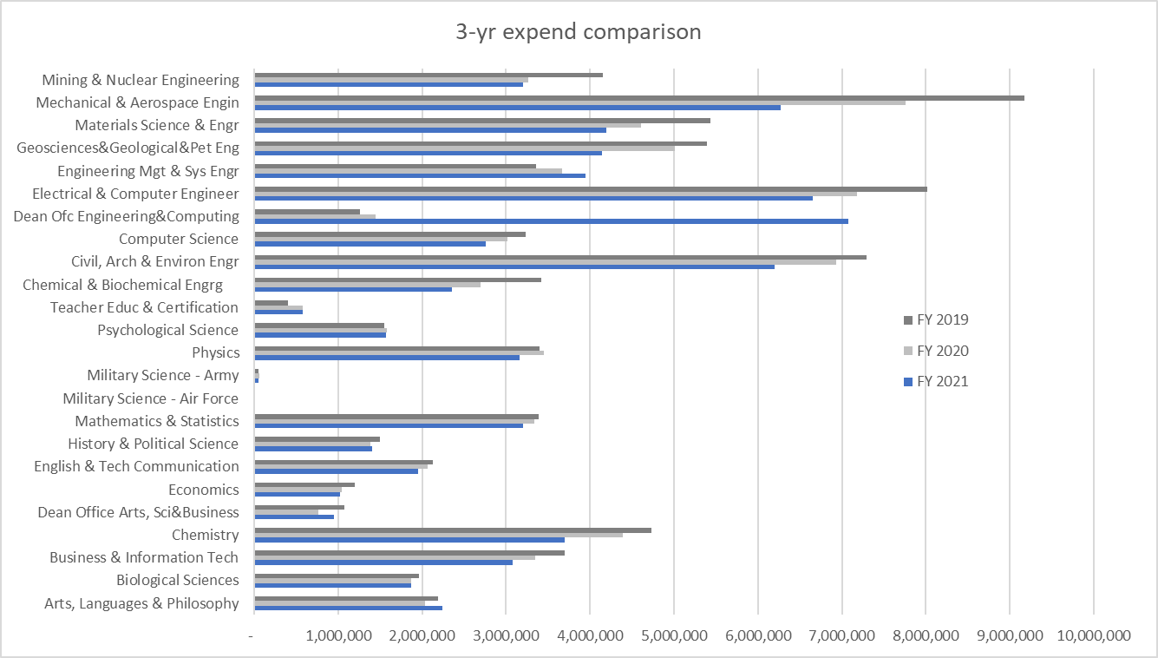
Expenditures ($)
$2.6 MM
Former administrators?
?
~20% decline

Slide 75
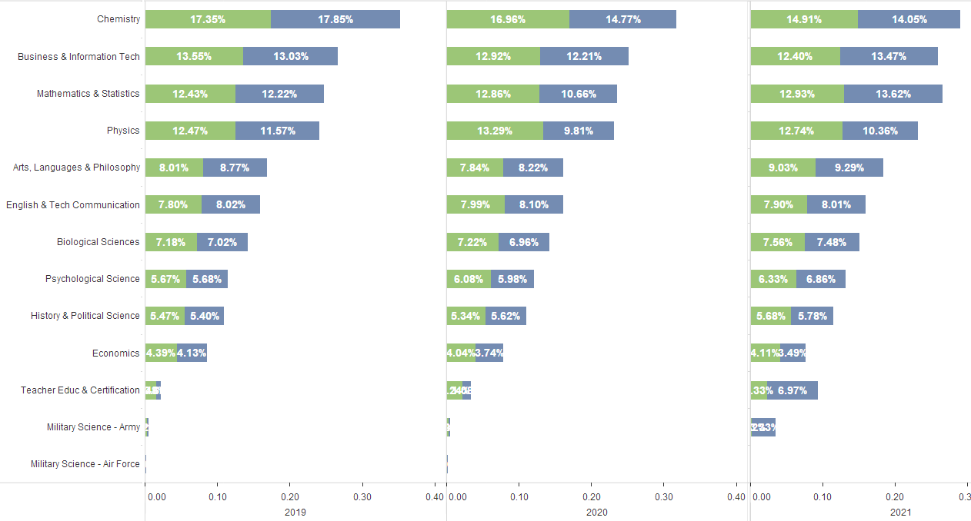
College of Arts, Sciences & Business
Dept Revenue & Transfer to total CASB Revenue & Transfer
(That’s plus one person)
Dept Expenditure to total CASB Expenditure

Slide 76
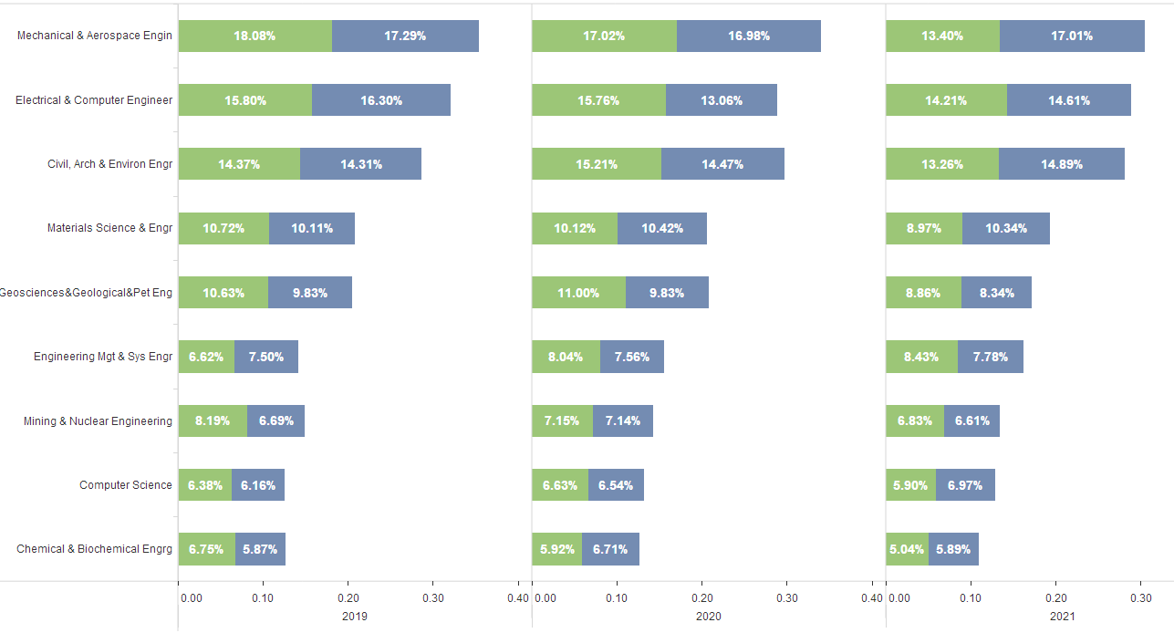
College Engineering & Computing
Dept Revenue & Transfer to total CEC Revenue & Transfer
Dept Expenditure to total CEC Expenditure

Slide 77
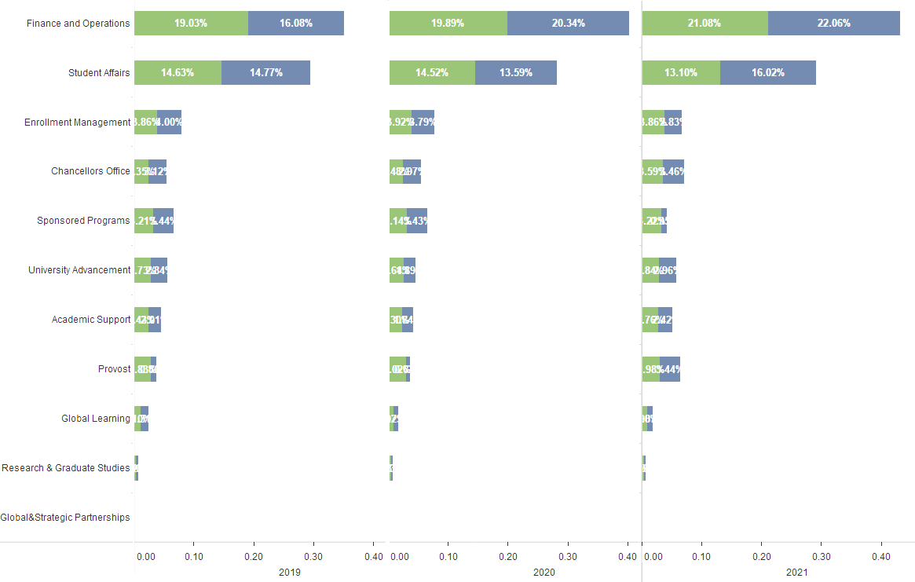
Non-Academic Units
$2 MM GO cut to Sponsored Proj, F&A funded, less F&A to others = passed along $1.8 MM of cut
Unit Revenue & Transfer to total S&T Revenue & Transfer
Unit Expenditure to total S&T Expenditure
Notes:
Finance & Operations: Business Services, Facilities Services, Fiscal Services, Human Resources, Information Technology, University Police, Vice Chancellor - Fin & Ops,

Slide 78
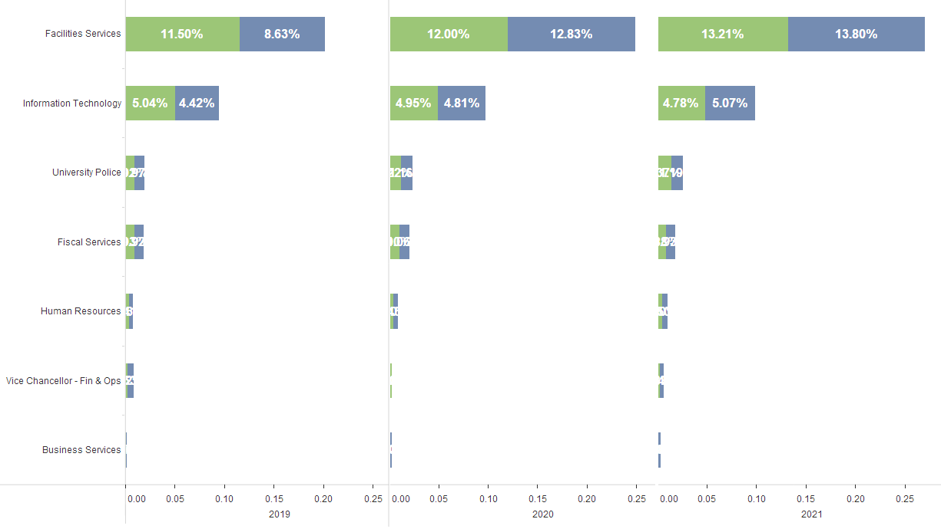
Finance & Operations

Slide 79
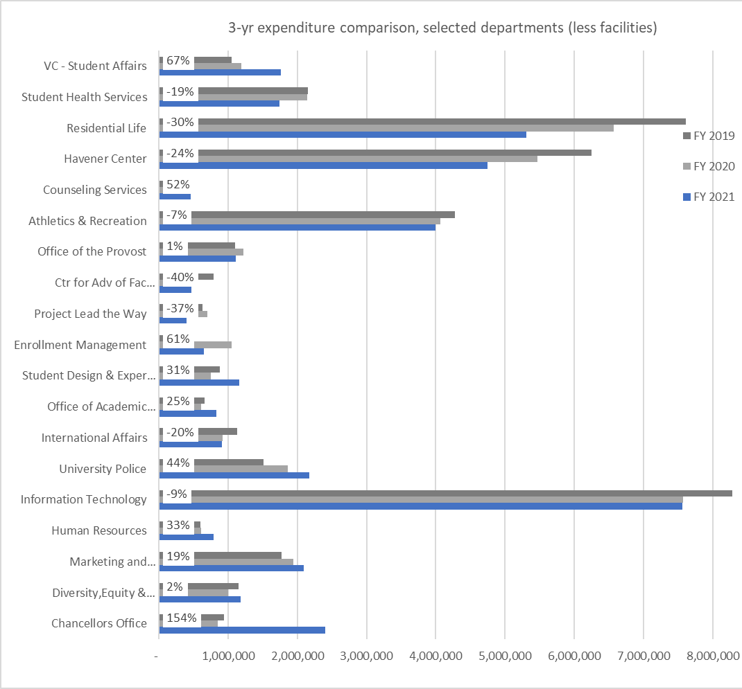
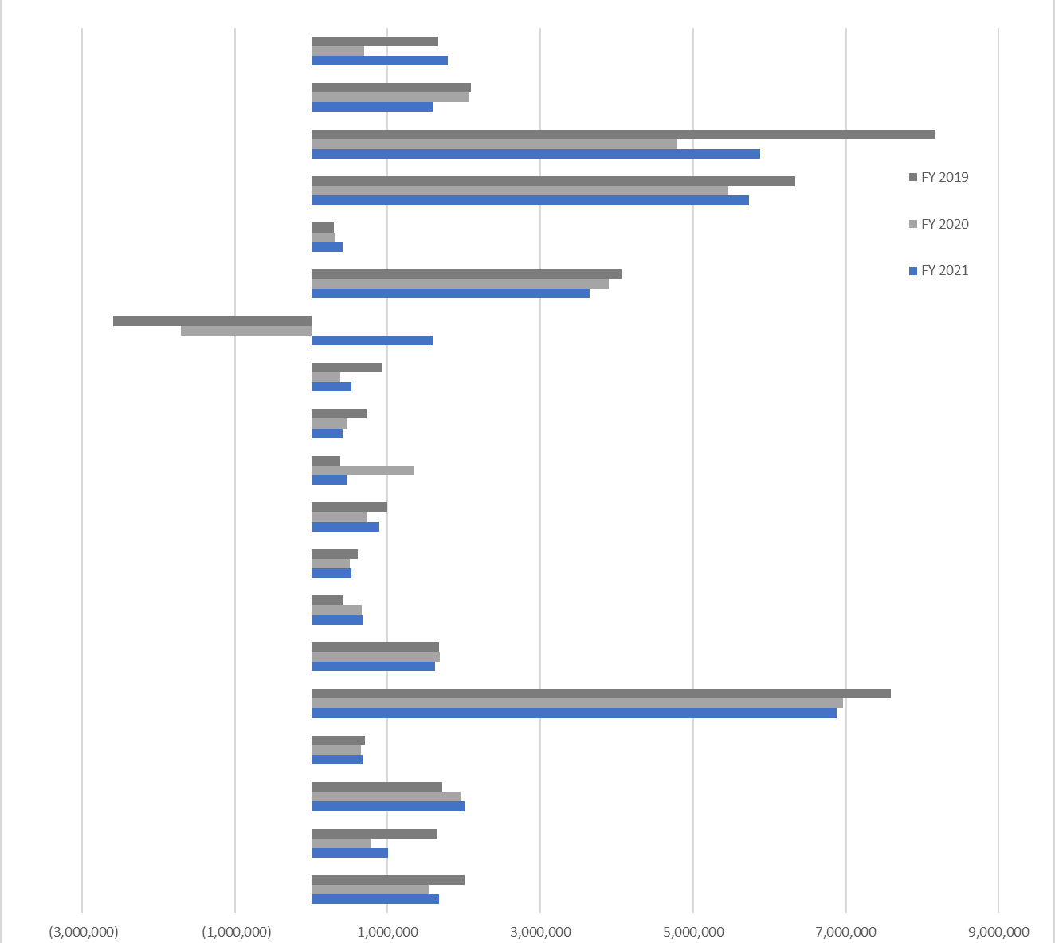
‘Income’
2020 $1.8 MM ‘loss’
2021 $1 MM ‘profit’
$0.74 MM loss over three yrs
Transfer out > revenue
2020 big cut
2020 big deficit, 2021 big cut
?
2021 big GO spend
Increased auxiliary spend
IT: $700K cut, continuing $600-700K annual deficit
2021 big spend (+1.5 MM endow, + 0.4 MM GO)

Slide 80
Three-year expenditure trends
Academic departments
Consistent cuts
Other departments
Some cuts
Some gains (many cases, might be hiring 1-3 positions)
Divisions
Student Affairs down 14% (-$3.35 MM)
CASB & CEC down 8.2% (-$6.4 MM)
Research & Grad studies down 3% (-$0.2 MM; shifted $5.5 MM from GO to F&A, F&A losses to others)
Advancement down 0% (-$0.005 MM)
Academic Affairs (Provost) w/o CASB and CEC down 1% (-$0.2 MM)
Finance & Operations up 6% ($2 MM)
Chancellor’s Office up 47% ($1.5 MM more endowment expend this year than last)

Slide 81
Agenda
VII. Reports of Standing Committees
G. Information Technology
J. Singler

Slide 82
Faculty senate referral to the ITCC:
Regarding the announced decommissioning of most greenscreen production classrooms, would the ITCC advise IT on the future of greenscreen production classrooms?
What instructional capabilities should be maintained or created?
After consulting with IT and Office of Finance, what technologies do you recommend for implementation that meets the goals of the desired instructional capabilities?
At what price point?

Slide 83
Would the ITCC advise IT on the future of greenscreen production classrooms?
Materials from IT about the greenscreen classroom reduction have been provided to the ITCC
The ITCC has received feedback from various sources on campus
The ITCC will form an ad hoc committee to investigate this issue
Feedback from the campus is welcome

Slide 84
Agenda
New Business
A. Ad Hoc Committee for Distance Education
S. Corns

Slide 85
Rules, Procedures, and Agenda Committee
Dr. Steven Corns, Chair RP&A Committee
January 28, 2021

Slide 86
Adhoc Committee on Distance Education
Committee to provide guidance on changes and updates to distance learning resources and procedures
Will work closely with BAC and ITCC
Hope to have good back and forth with CAFÉ and Global Learning

Slide 87
Agenda
IX. Adjourn
87

